Slide 1

SwiftUI
Welcomt To SwiftUI workshop
Presenter: Abdullah Alhaider

Slide 2
SwiftUI
What is SwiftUI?
@cs4alhaider

Slide 3
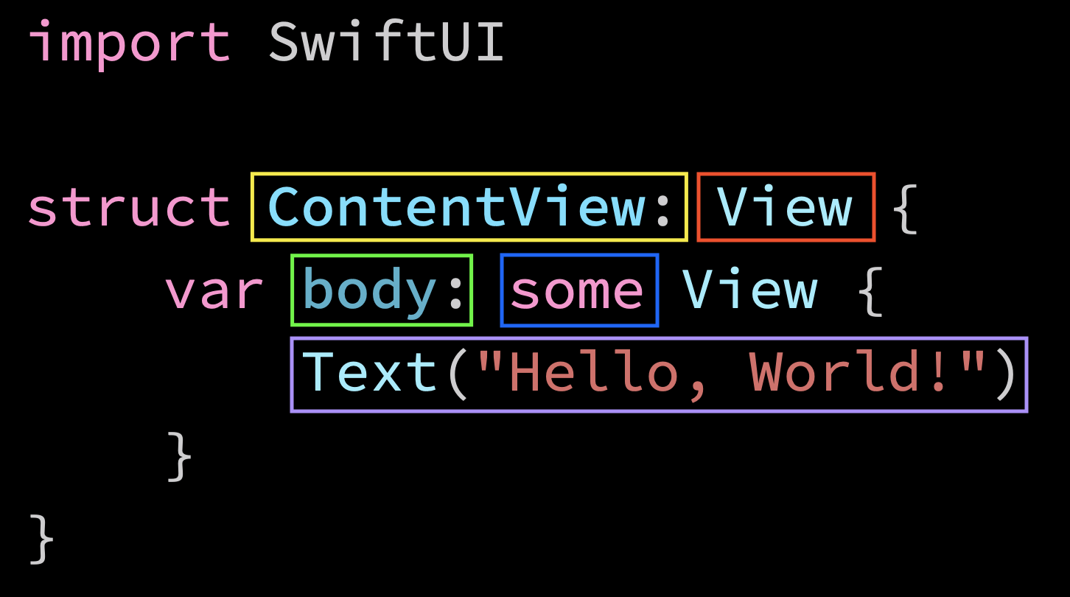
SwiftUI
@cs4alhaider

Slide 4
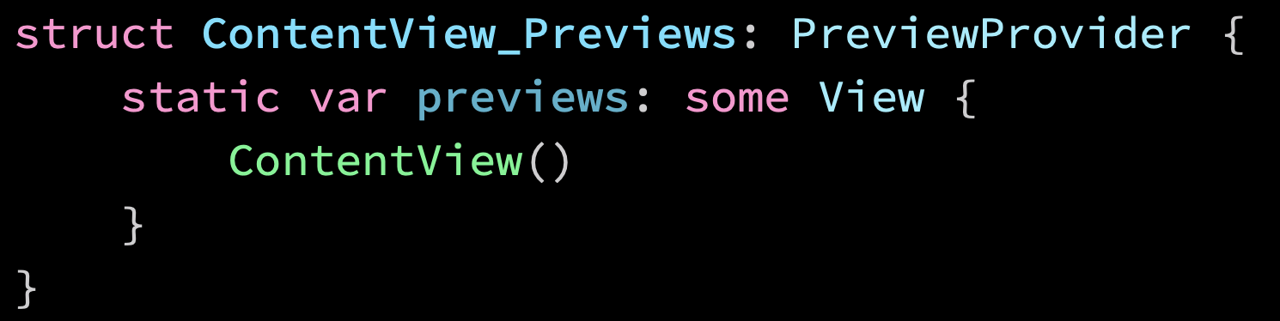
SwiftUI
@cs4alhaider

Slide 5
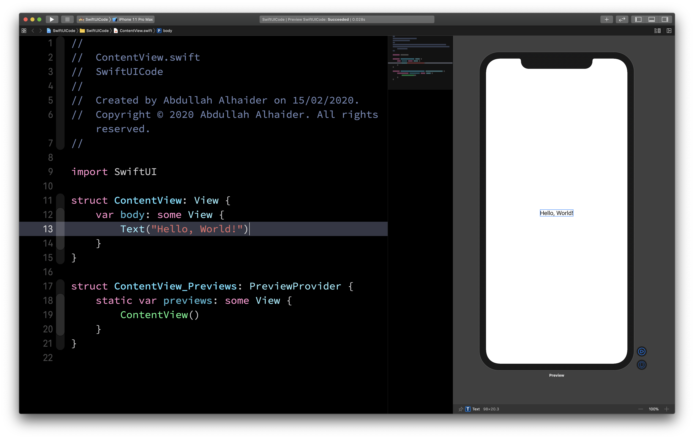

Slide 6
SwiftUI
SwiftUI Components
@cs4alhaider

Slide 7
SwiftUI
Button
@cs4alhaider

Slide 8
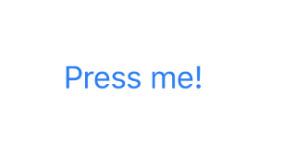
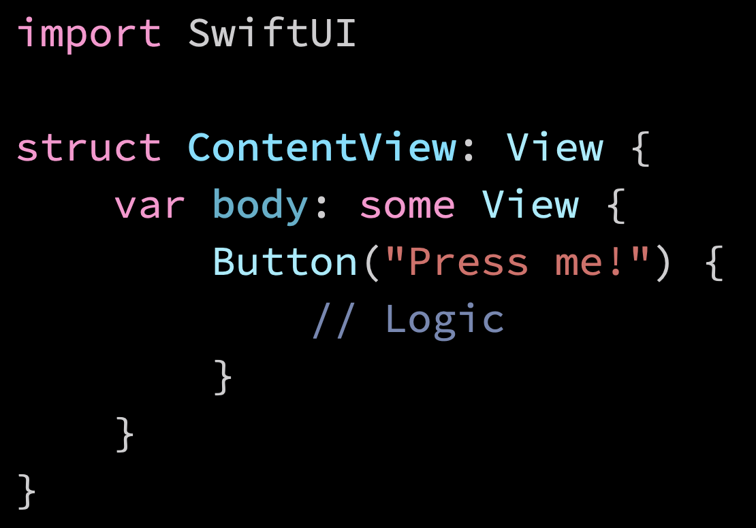
SwiftUI
@cs4alhaider

Slide 9
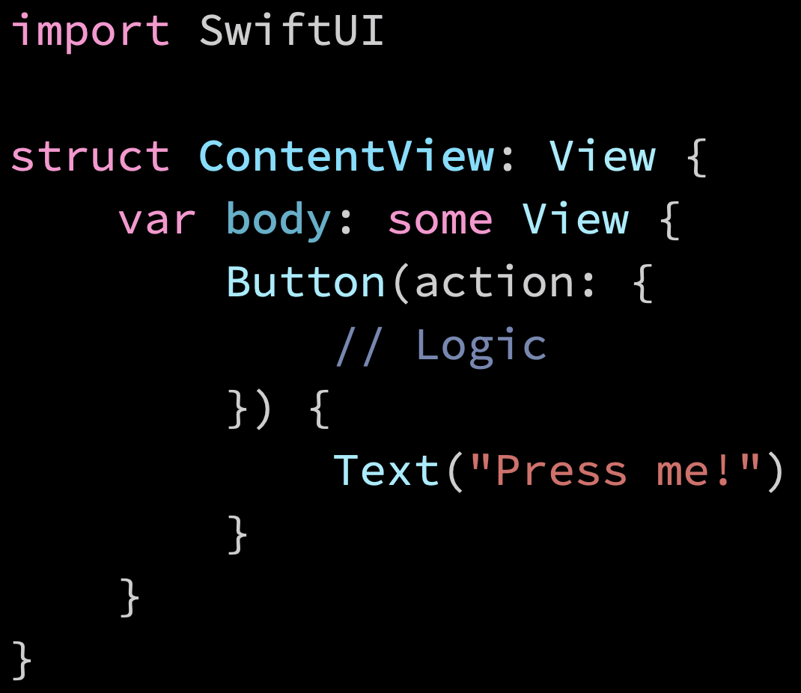
SwiftUI
@cs4alhaider

Slide 10
SwiftUI
TextField
@cs4alhaider

Slide 11

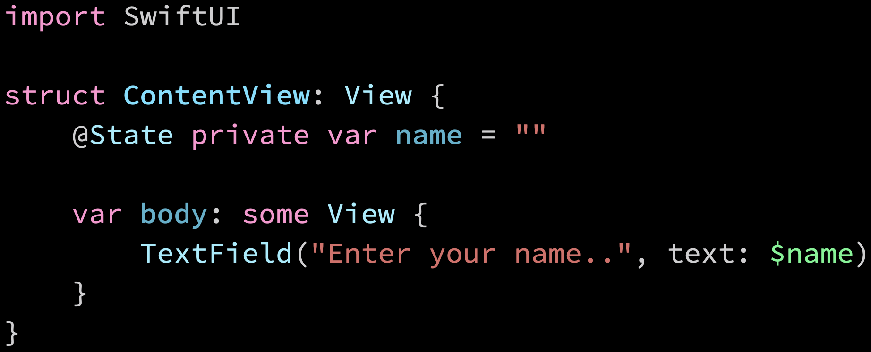
SwiftUI
@cs4alhaider

Slide 12
SwiftUI
List
@cs4alhaider

Slide 13
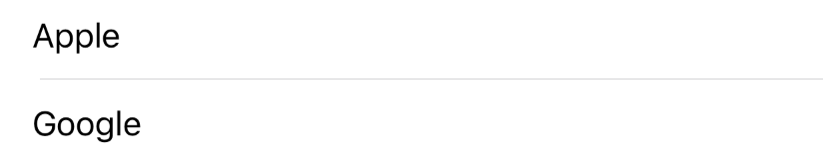
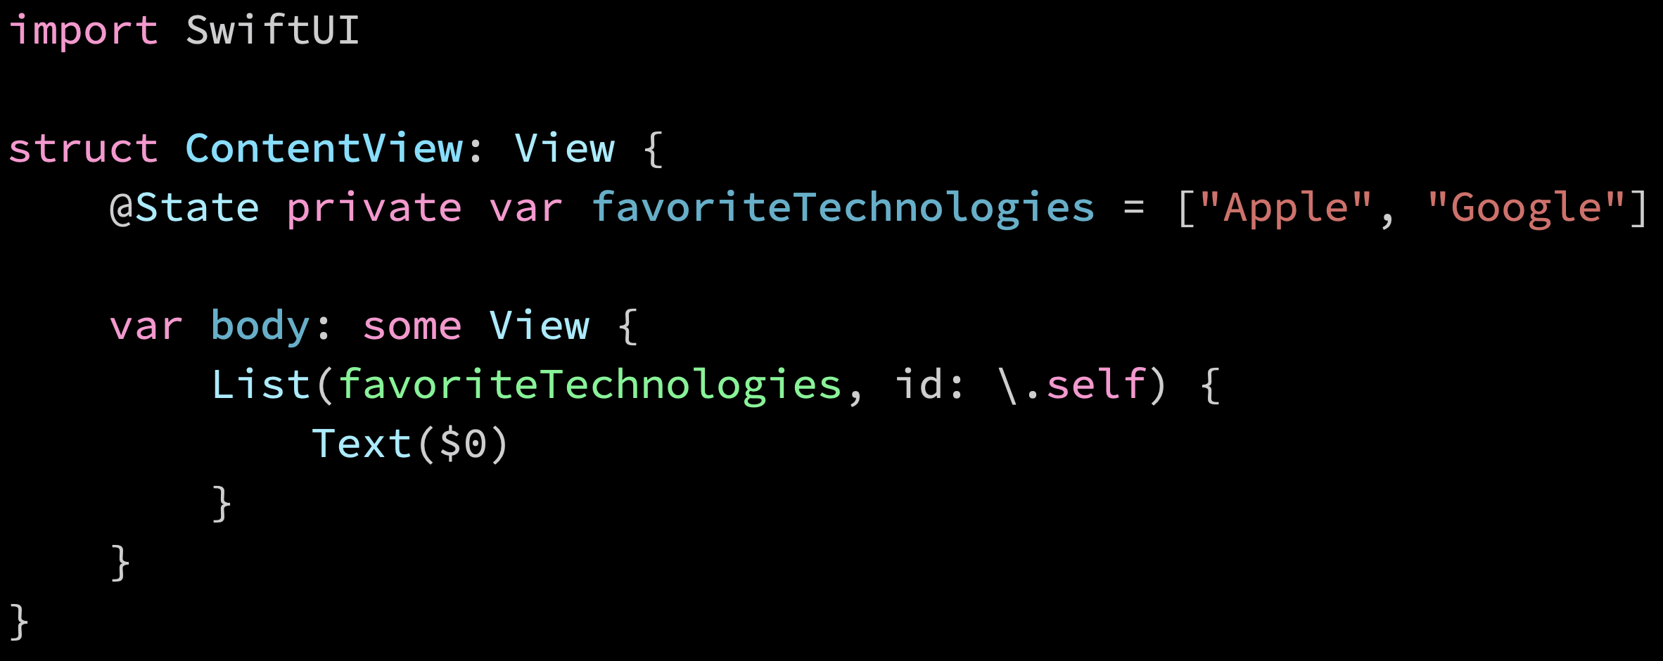
List
@cs4alhaider

Slide 14
SwiftUI
Stack
@cs4alhaider

Slide 15

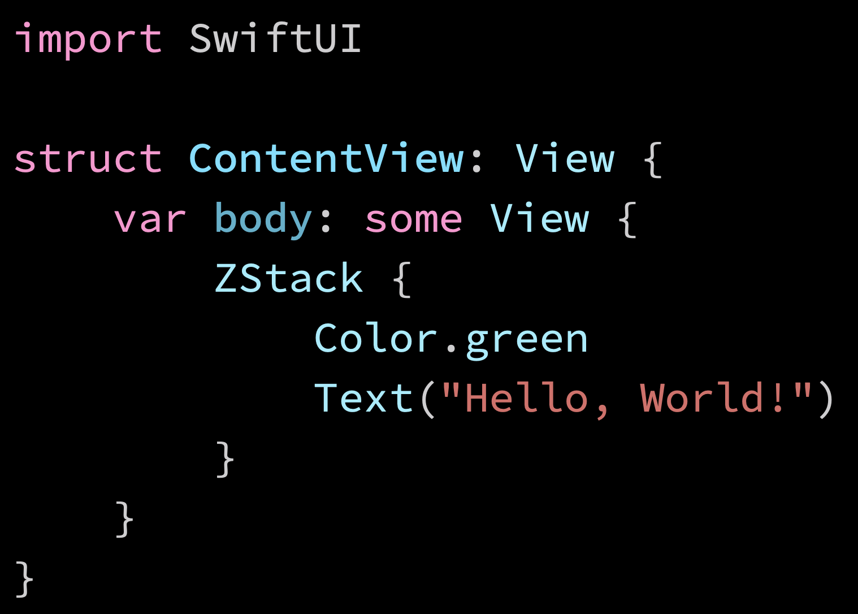
Stack
@cs4alhaider

Slide 16
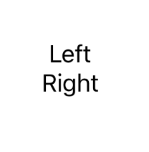
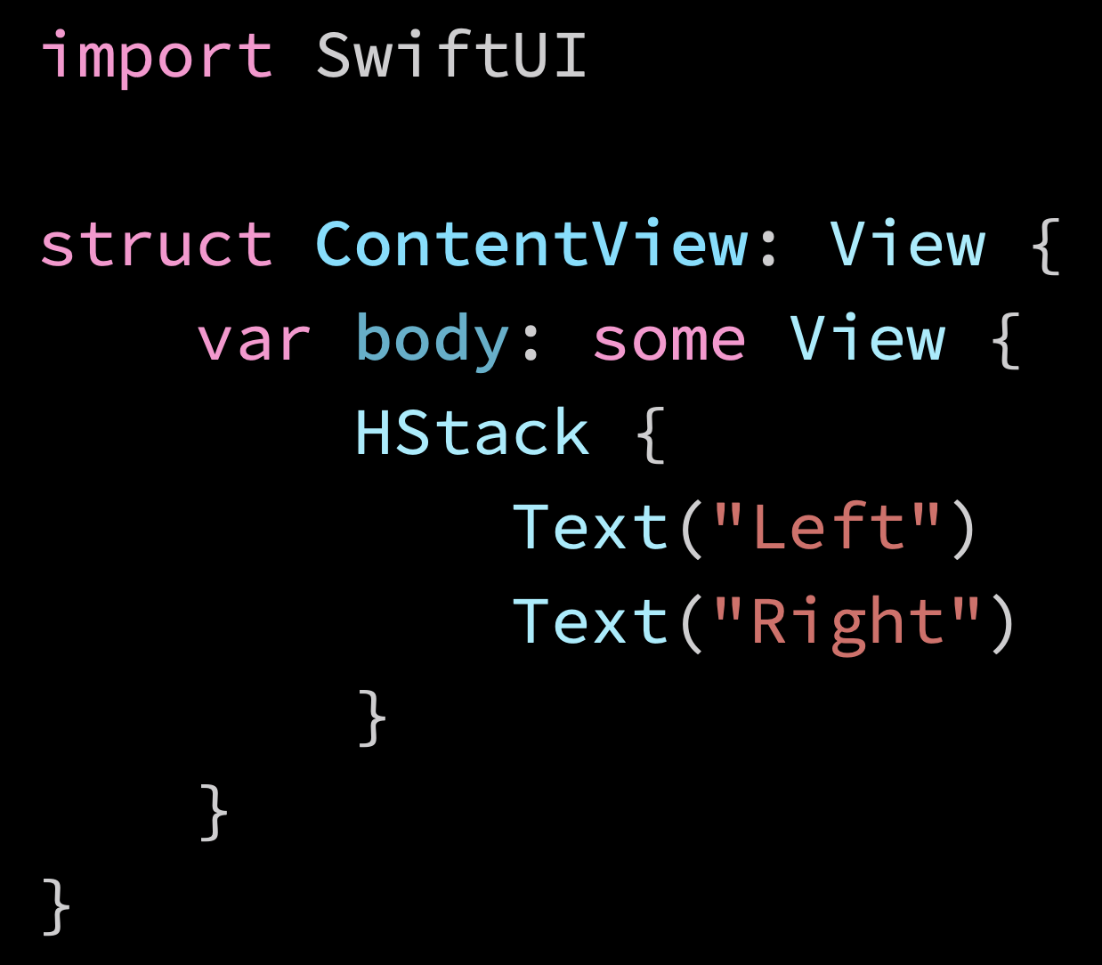
Stack
@cs4alhaider

Slide 17

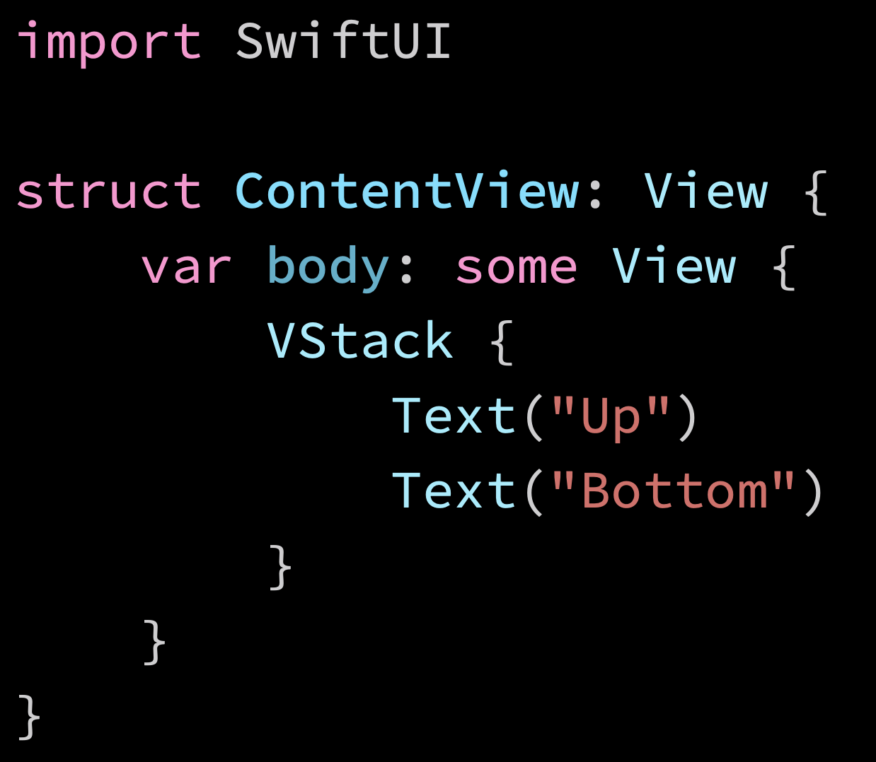
Stack
@cs4alhaider

Slide 18
SwiftUI
Padding
@cs4alhaider

Slide 19
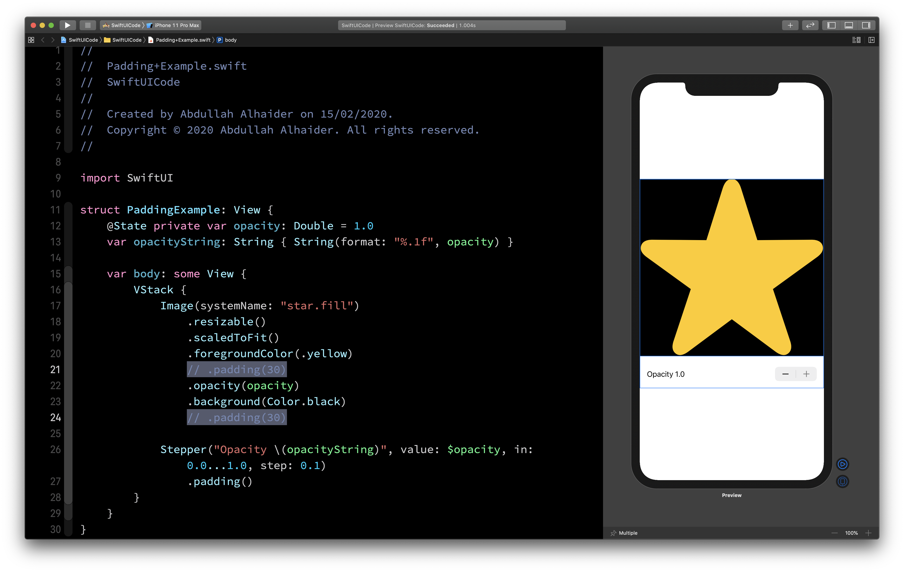
Padding
@cs4alhaider

Slide 20
SwiftUI
Views Modifier
@cs4alhaider

Slide 21
SwiftUI
Modifiers Order!
@cs4alhaider

Slide 22
SwiftUI
SwiftUI + Combine = 💙
https://developer.apple.com/documentation/combine
@cs4alhaider

Slide 23
SwiftUI
@ObservableObject
@cs4alhaider

Slide 24
SwiftUI
@Publisher
@cs4alhaider

Slide 25
SwiftUI
@ObservedObject
@cs4alhaider

Slide 26
SwiftUI
Ticker App
@cs4alhaider

Slide 27
SwiftUI
CoreData
@cs4alhaider

Slide 28
SwiftUI
Where to go from here?
@cs4alhaider

Slide 29

SwiftUI
@cs4alhaider

